Slide 1
Providing Insights to the Marketing Team in Food & Beverage Industry CodeX
Ideas for today and tomorrow

Slide 2
Abstract
CodeX is a German beverage company that is aiming to make its mark in the Indian market. A few months ago, they launched their energy drink in 10 cities of India.
Their Marketing team is responsible for increasing brand awareness, market share, and product development. They conducted a survey in those 10 cities and received results from 10k respondents.
Here Our aim is to convert these survey results to meaningful insights which the team can use to drive actions.

Slide 3
Introduction
In this project there are several variables that will have a significant effect on the brand awareness ,market share, and product development.
Marketing channel
Age Group
Gender
Drink Ingredients
Packaging Preferences
Price range etc..

Slide 4
Objective
Determine how the Marketing channel, Age Group ,Gender ,Drink Ingredients ,Packaging Preferences, Price range and purchase location etc.. affect brand awareness ,market share, and product development. within the dataset.

Slide 5
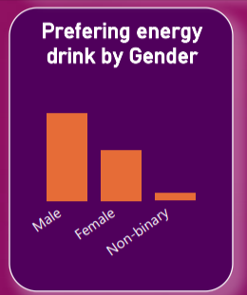
Demographic Insights
Who prefers energy drink more? (male/female/non-binary?)
Analysis: Based on the data presented in the graph, it appears that males are the most frequent consumers of energy drinks, followed by females, and then non-binary individuals. This suggests a gender disparity in energy drink preference, with males being the largest consumer group.

Slide 6
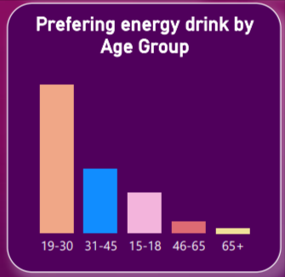
Demographic Insights
Which age group prefers energy drinks more?
Analysis: Graph reveals that the age group between 19 and 30 demonstrates the highest preference for energy drinks. This segment appears to be the most significant consumer group, followed by the age groups of 31-45 and 15-18

Slide 7
Demographic Insights
Which type of marketing reaches the most Youth (15-30)?

Slide 8
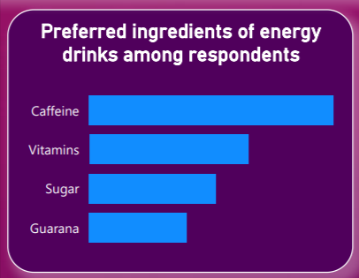
Consumer Preferences
What are the preferred ingredients of energy drinks among respondents?
Analysis: The results indicate that caffeine is the most preferred ingredient, followed by vitamins, and then sugar.

Slide 9
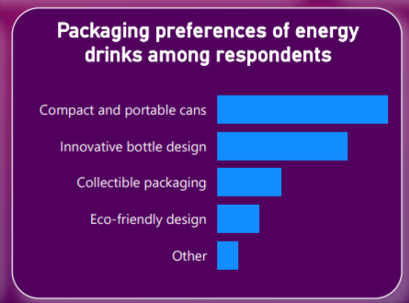
Consumer Preferences
What packaging preferences do respondents have for energy drinks?
Analysis: The respondents overwhelmingly preferred compact and portable cans as their top choice for energy drink packaging.
The second most preferred option was innovative bottle designs, suggesting that consumers appreciate unique and eye-catching packaging

Slide 10
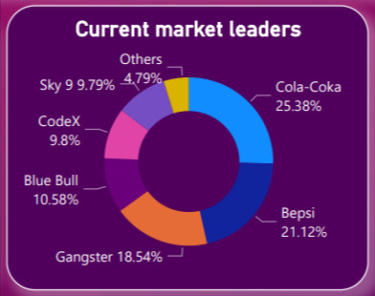
Competition Analysis
Who are the current market leaders?
Analysis: The results suggests that Cola-Coka holds the highest market share and consumer preference among the mentioned energy drink brands, followed by Bepsi and Gangster. The ranking of these brands indicates their relative popularity in the market.

Slide 11
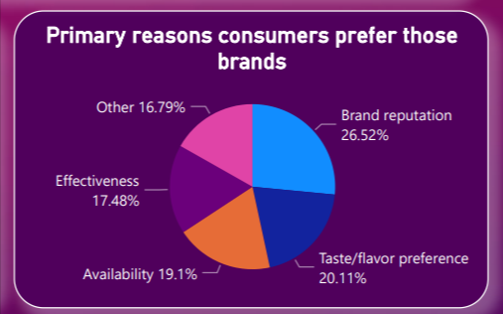
Competition Analysis
What are the primary reasons consumers prefer those brands over ours?
Analysis: In analyzing the graph, it becomes evident that brand reputation emerges as the primary factor influencing consumer preference. This indicates that consumers value and trust established brands more than ours. Additionally, taste/flavor preference and availability are also crucial factors contributing to consumers' brand preferences.

Slide 12
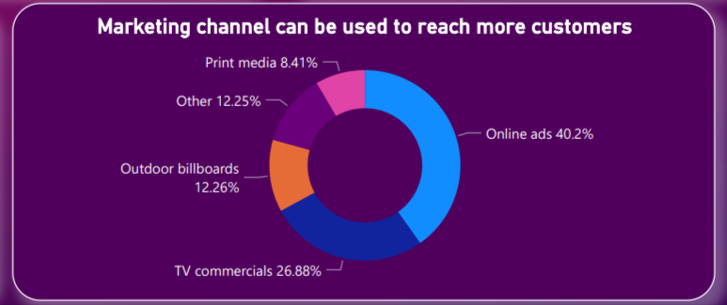
Marketing Channels and Brand Awareness
Which marketing channel can be used to reach more customers?
Analysis: . This suggests that businesses prioritize online advertising as an effective means of reaching a wider audience, while still recognizing the value of television and outdoor advertising in their marketing strategies.

Slide 13
Marketing Channels and Brand Awareness
How effective are different marketing strategies and channels in reaching our customers?

Slide 14
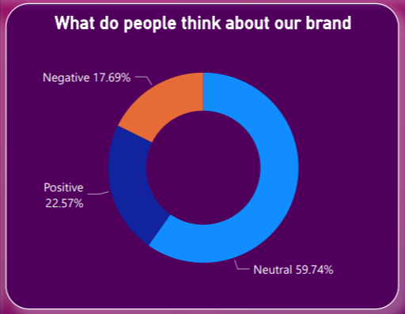
Brand Penetration
What do people think about our brand? (overall rating)
Analysis: Based on the graph, the overall rating of our brand indicates a mixed sentiment among people. While a significant portion of individuals hold a neutral view, there is also a positive sentiment among some respondents.

Slide 15
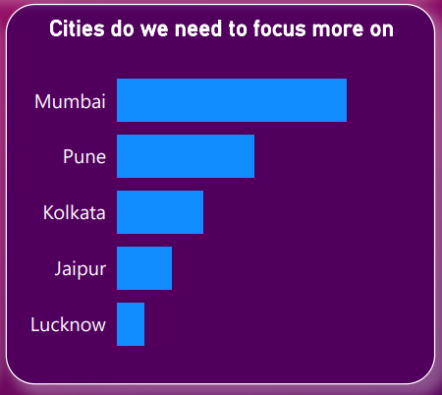
Brand Penetration
Which cities do we need to focus more on?
Analysis: Based on the graph data, the top 5 cities to focus on for the Marketing Team in the Food & Beverage Industry are Mumbai, Pune, Kolkata, Jaipur, and Lucknow.

Slide 16
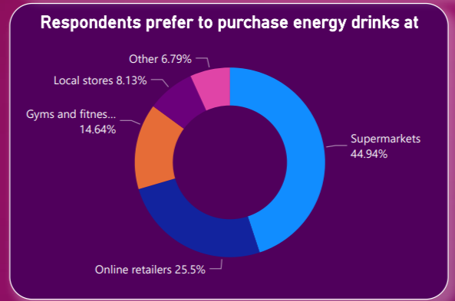
Purchase Behavior
Where do respondents prefer to purchase energy drinks?
Analysis: The majority of respondents indicated a preference for purchasing energy drinks at supermarkets, followed by retailers, gyms and fitness centers, and finally local stores..

Slide 17
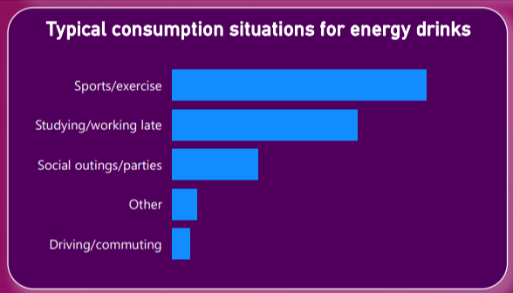
Purchase Behavior
What are the typical consumption situations for energy drinks among respondents?
Analysis: The most typical consumption situations for energy drinks among respondents are sports/exercise, studying/working late, and social outings/parties.

Slide 18
Purchase Behavior
What factors influence respondents' purchase decisions, such as price range and limited edition packaging?

Slide 19
Product Development
Which area of business should we focus more on our product development? (Branding/taste/availability)

Slide 20
Conclusion
1. Gender disparity in energy drink preference: Males are the largest consumer group, followed by females and non-binary individuals.
2. Age group preference: The age group between 19 and 30 demonstrates the highest preference for energy drinks, followed by the age groups of 31-45 and 15-18.
3. Packaging preference: Consumers overwhelmingly prefer compact and portable cans, followed by innovative bottle designs, indicating a preference for convenience and visually appealing packaging.
4. Brand preference: Cola-Coka holds the highest market share and consumer preference among the mentioned energy drink brands, followed by Bepsi and Gangster.
5. Factors influencing brand preference: Brand reputation, taste/flavor preference, and availability are the primary factors influencing consumer brand preferences.
6. Advertising preferences: Online advertising is prioritized, followed by television and outdoor advertising, indicating the importance of a multi-channel marketing strategy.
7. Overall brand sentiment: The sentiment toward our brand is mixed, with a significant portion of respondents holding a neutral view and some expressing positive sentiment.

Slide 21
Conclusions
8. Target cities for marketing: Mumbai, Pune, Kolkata, Jaipur, and Lucknow are the top cities to focus on for the Marketing Team in the Food & Beverage Industry.
9. Preferred purchase locations: Supermarkets are the preferred purchase location for energy drinks, followed by retailers, gyms and fitness centers, and local stores.
10. Typical consumption situations: The most typical consumption situations for energy drinks are sports/exercise, studying/working late, and social outings/parties.

Slide 22
Recommendation
What immediate improvements can we bring to the product?
What should be the ideal price of our product?
What kind of marketing campaigns, offers, and discounts we can run?
Who can be a brand ambassador, and why?
Who should be our target audience, and why?

